Slide 1


Slide 2
Kubernetes : Deployments
info@zekeLabs.com | www.zekeLabs.com | +91 8095465880

Slide 3
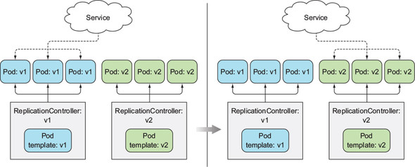
BLue Green Deployment

Slide 4
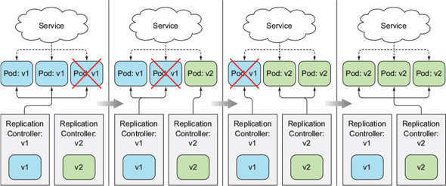
Rolling update using RC

Slide 5
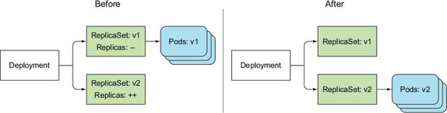
A Deployment at the start and end of a rolling update

